Slide 1
Formation of the Barbarian States

Slide 2
Vocabulary
Origin – Původ
Roots – Kořeny
To settle - Usadit
To invade - Napadnout
To establish - Založit
To forge out - Vytvořit
Nails - Hřebíky
Cricifixion - Ukřižování
Tribe - Kmen
To last - Trvat
To terminate - Ukončení
Raids - Nájezdy
Gradually - Postupně
Unified - Sjednocený

Slide 3
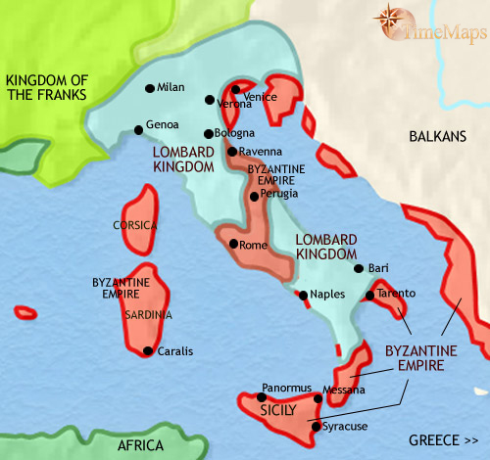
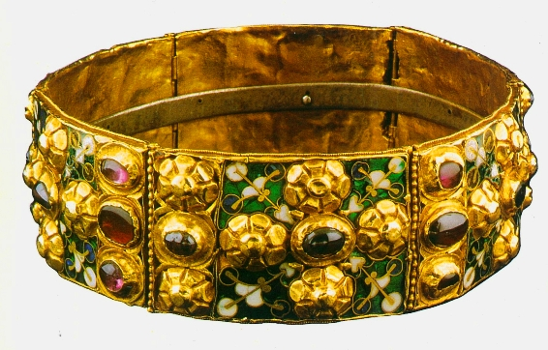
The Lombards
Germanic origin (Northern part of Europe)
The river Danube
Byzantine Italy
Charlemagne 774
Iron Crown

Slide 4
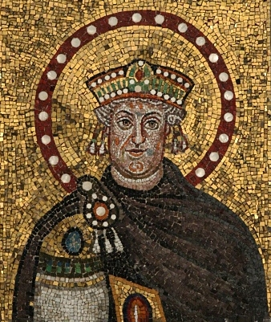
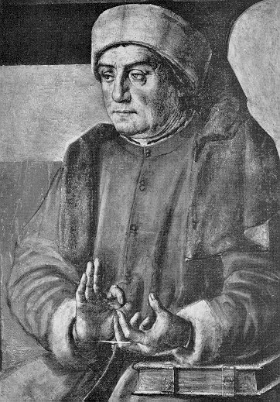
The Ostrogoths
Germanic origin
Italy
50 years
Byzantines
Theodorich the Great
Boethius

Slide 5
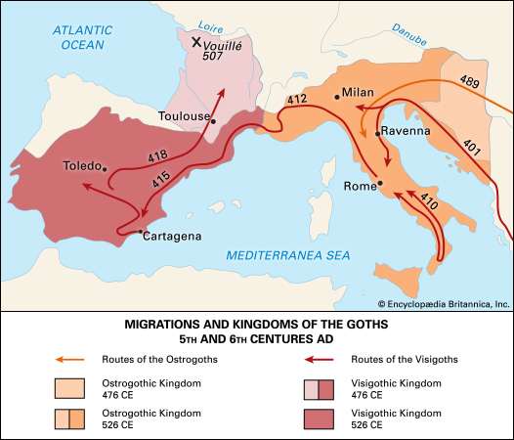
The Visigoths
Germanic tribe
Southern France
City Toledo
5th century
711 Arab raids

Slide 6
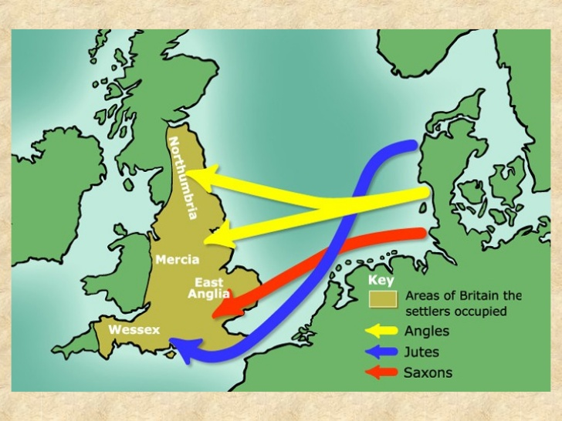
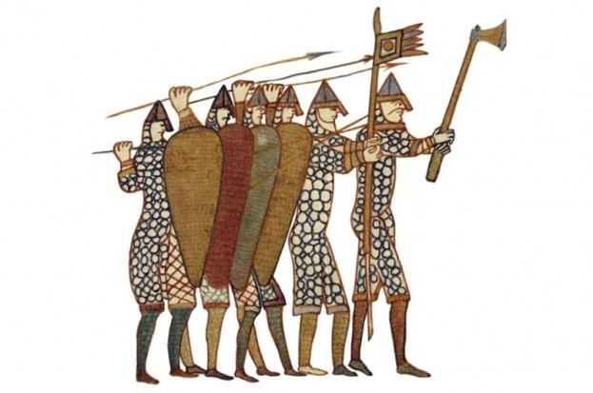
The Angles and Saxons
Germanic tribes
6th & 7th centuries – Celts
7 little kingdoms
9th century - Normans

Slide 7
Thank you for your attention

